Slide 1
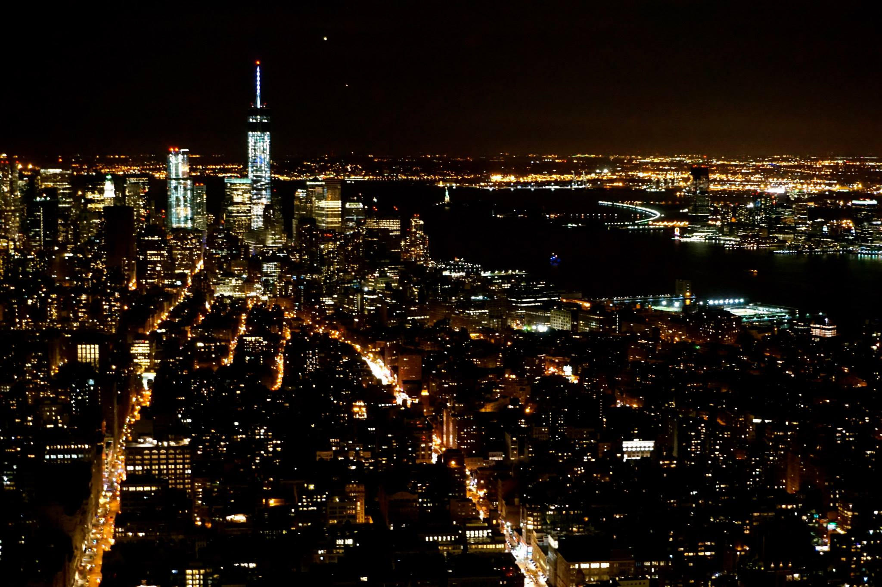
IBM Data Science Professional Certificate
Capstone Project - The Battle of Neighborhoods
Teng-Kuei Hsu
May, 2019

Slide 2
INTRODUCTION
According to United Nations report, more than half of the world’s population lives in urban areas, and the proportion is expected to increase to 70 percent by 2050.
Critically, economists and urbanists have found the connection between urbanization and economic development.
By comparing the Foursquare Venue Category data of high population density cities to low density cities, critical features might emerge and shed light on the direction of city development.

Slide 3

INTRODUCTION
According to United Nations report, more than half of the world’s population lives in urban areas, and the proportion is expected to increase to 70 percent by 2050.
Critically, economists and urbanists have found the connection between urbanization and economic development.
https://www.un.org/development/desa/publications/2018-revision-of-world-urbanization-prospects.html

Slide 4

INTRODUCTION
Here, by comparing the Foursquare Venue Category data of high population density cities to low density cities, critical features might emerge and shed light on the direction of city development.

Slide 5
DATA ACQUISITION
The population density data of US cities could be obtained from governing website (https://www.governing.com/gov-data/population-density-land-area-cities-map.html).

Slide 6
DATA ACQUISITION
All the venues surrounding the geographic coordinates of these cities will be collected from Foursquare API.
The detailed list of venue categories can be found on the foursquare website . https://developer.foursquare.com/docs/resources/categories

Slide 7
METHODOLOGY
Acquire population density data of US cities:
- Python library BeautifulSoup and requests
Acquire the geographic coordinate of the US cities
- Python library Geopy
Spatial visualization of population density of US cities
- Python library Folium
Collect the Nearby Venues
- Foursquare API

Slide 8
METHODOLOGY
Correlation between the venue frequency and population density:
- Pandas.dataframe.corr()
Predict population density with Machine Learning approaches
Python library sklearn K Nearest Neighbor, Decision Tree, and Logistic Regression
Evaluated by accuracy score and F1 score.

Slide 9
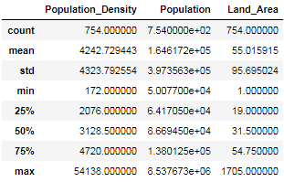
RESULTS
Figure 1. Basic statistics of population density data from governing website

Slide 10
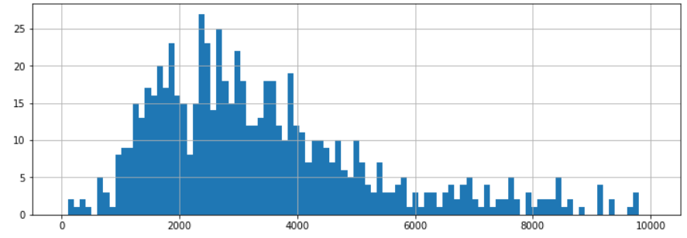
RESULTS
Number of cities
Population density
Figure 2. Histogram of population density (0-10000 persons in square miles).

Slide 11
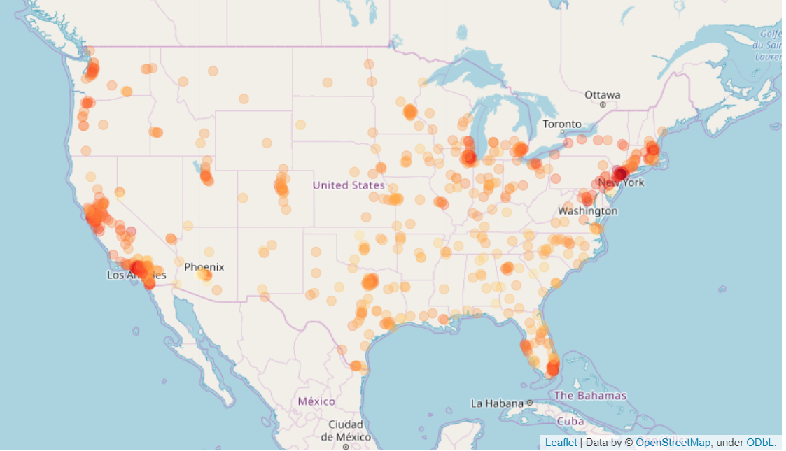
RESULTS
Figure 3. Spatial visualization of population density of US cities.
The population density of the city is correlated to the color intensity of the marker. Higher population density is indicated by a darker shade of red.

Slide 12
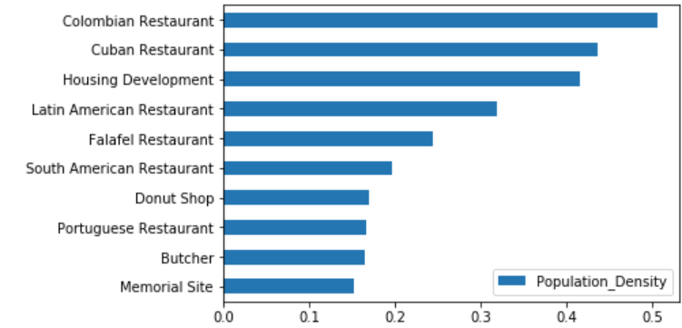
RESULTS
Figure 4. (A) Top 10 venue categories that are positively correlated with population density.

Slide 13
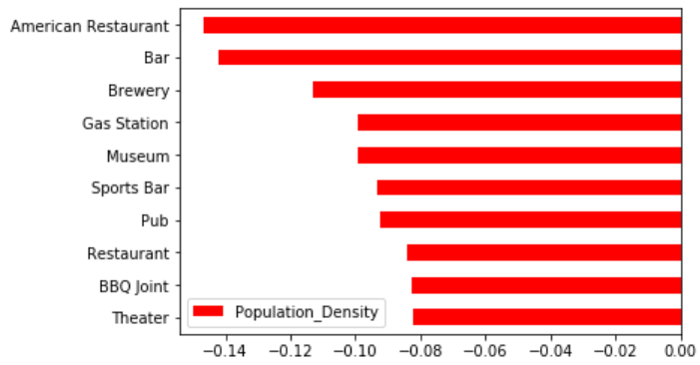
RESULTS
Figure 4. (B) Top 10 venue categories that are negatively correlated with population density.

Slide 14
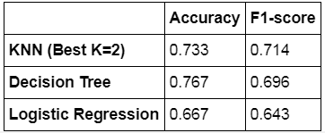
RESULTS
Figure 5. The accuracy and F1-score of K Nearest Neighbor, Decision Tree, and Logistic Regression in predicting the population density based on the composition of venues.

Slide 15
DISCUSSION
The diverse restaurant types that are positively correlated with population density come from different cultures, indicated population diversity.
Population diversity has been known to lead to economic growth, this might explain why urbanization is connected to economic development.

Slide 16
DISCUSSION
The accuracy suggests the composition of venues can partially explain the population density, but other components might also exist.

Slide 17
CONCLUSION
In conclusion, these data suggest the population diversity is positively correlated with population density in the US cities, which reflected on the diversity of restaurants in high population density cities.
Since the population diversity leads to economic growth, this might partially explain how urbanization is connected to economic growth.

